Slide 1
Goal Orientated Behaviour
Utility AI

Slide 2
Reactive Systems
Most of the methods seen so far are reactive
They do not account for AI motivations
Or desires
Doing this with other methods results in excessive complexity
These methods can superficially appear to have desires
But not very flexible
Also, AI cannot take initiative
Can only react to external state

Slide 3
Goal Orientated Behaviour (GOB)
A solution is to give AI a set of goals
And a choice of actions to take
Choose the action which most satisfies the goal
E.g. if AI is hungry, choose an ‘eat’ action
Goals change in response to world and internal state
E.g. enemy near increases ‘kill enemy’ goal
Damage increases ‘heal’ goal

Slide 4
Goals
AI stores a list of goals
Goals can be modified by an insistence value
Also called utility value
Usually represented by a number
Can be Boolean if space needs to be conserved
Represents current importance of goal
AI will try to reduce insistence level
An insistence level of zero means goal is entirely satisfied

Slide 5
Actions
Actions can be represented by the action class discussed before
With an added attribute
The amount by which insistence is reduced by performing action
Different actions can reduce insistence of different (or the same) goals by different amounts
Action which satisfies highest insistence by greatest amount is selected
If multiple actions satisfy same insistence by equal amount, choose at random

Slide 6
Example Goals & Actions
Goal | Insistence
Eat | 4
Sleep | 3
Action | Insistence Reduction
Get Meal | Eat -3
Get Snack | Eat -2
Sleep in Bed | Sleep -4
Nap On Sofa | Sleep -2

Slide 7
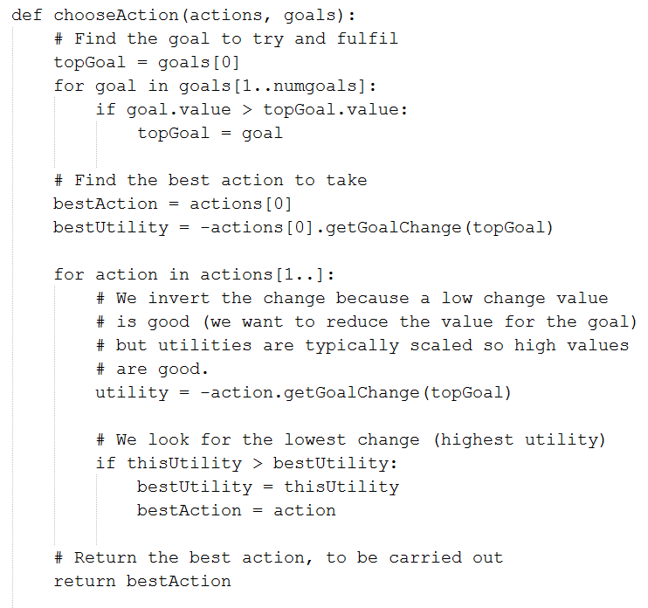
Pseudocode

Slide 8
Utility Functions
In the example above insistence has a fixed value
More flexible is to use functions to determine insistence value
Allows different AI characteristics
These can be:
Linear
Step function e.g. binary
Exponential
Logarithmic
Sigmoid

Slide 9
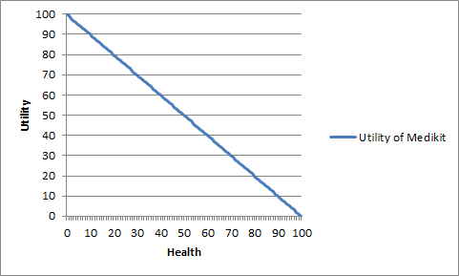
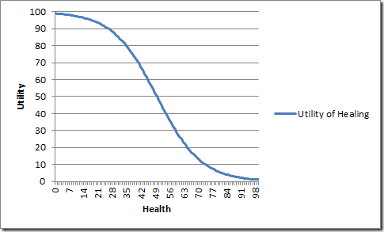
Heal Example
Linear Utility Function
Sigmoid Utility Function
Ref: https://alastaira.wordpress.com/2013/01/25/at-a-glance-functions-for-modelling-utility-based-game-ai/

Slide 10
Overall Utility
The above algorithm works well for simple situations
But in a more realistic situation
Actions might have side effects e.g.
Goal | Insistence
Eat | 4
Bathroom | 3
Action | Insistence Change
Drink Soda | Eat -2, Bathroom +3
Visit Bathroom | Bathroom -4

Slide 11
Action Side Effect Problem
If we use these actions
The highest insistence is for Eat
However, satisfying eat increases Bathroom insistence to highest
In reality, a human would delay the snack
And use the bathroom
In the worst case could be fatal
E.g. running into enemy to get health pack
How do we solve this?

Slide 12
Discontent Value
A solution is to sum all the insistence values
Into an overall discontent value
It is better to square the insistence values first
To prevent many middling values swamping result
Each action is considered in turn
Total overall discontent is calculated as if action was taken
Action which reduces overall discontent most is chosen

Slide 13
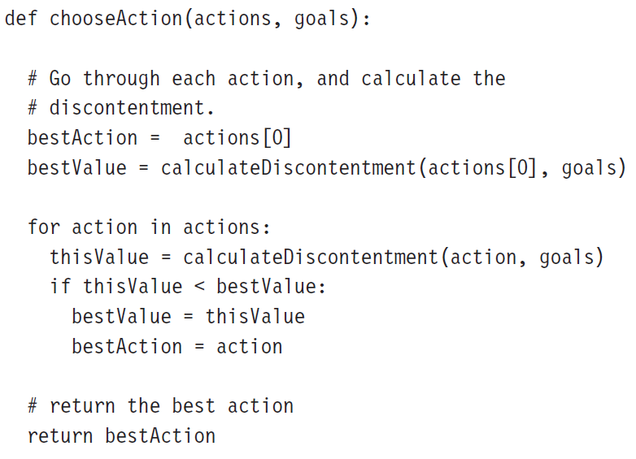
Overall Discontent Pseudocode

Slide 14
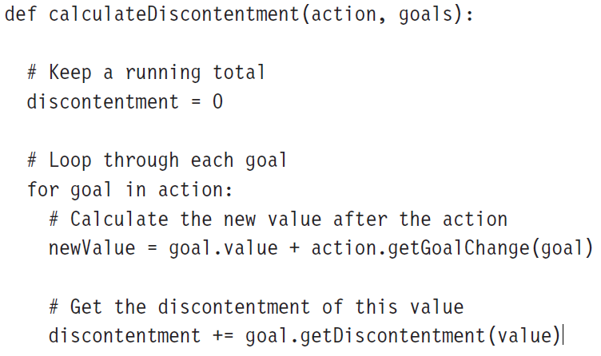
Calculating Overall Discontent

Slide 15
Timing
Another problem with goal orientated AI
Time to perform action is not considered
If an insistence is urgent
An action which takes a long time to complete may not be the best
Better to try something quick
Even if insistence satisfaction is less

Slide 16
Problems With Time
Sometimes calculating time is hard
E.g. pathfinding
Computationally expensive to run pathfinding just to check time
Must use heuristic e.g. direct line distance
Two components with time
How long action takes
How long to get to location to perform action
Where to add time calculation
Utility calculation
Or overall discontent calculation
Goal values can change over time
E.g. hunger

Slide 17
Factoring In Time
Goals can have an insistency change factor
E.g. Goal: Hunger 4 + 4 per hour
Time for insistency change
Can be hard coded in
Or calculated by tracking time taken for previous changes
Time taken for action
Can be hard coded
Or tracked by storing time taken previously
Or calculated, but beware of performance

Slide 18
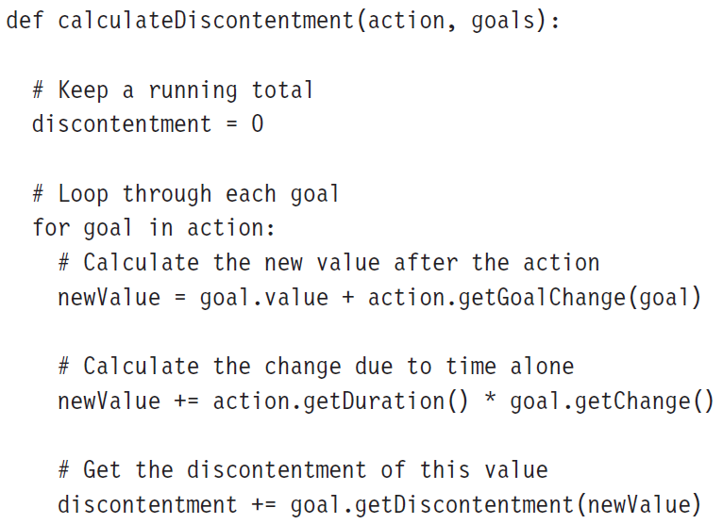
Time Calculation Pseudocode

Slide 19
Pros And Cons
Very robust
Will usually perform sensible action in any situation
Flexible
Can cope with wide variety of situations
Can express different AI characteristics
Can model emotional states
If number of goals and actions is large
Can be computationally demanding

